Slide 1
UEFI Crypto Agile (v 0.3)
Jiewen Yao, November 3, 2021

Slide 2
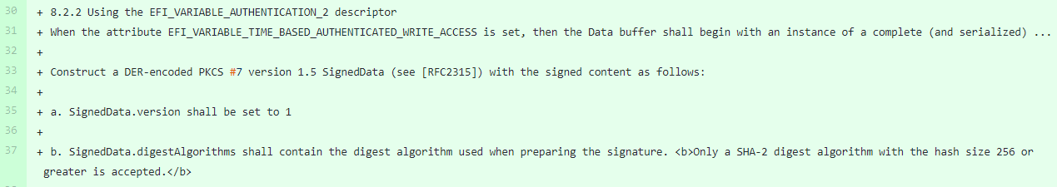
Background
[AuthService]: Digest Algorithm update for Authenticated Variables
https://bugzilla.tianocore.org/show_bug.cgi?id=2950
[Unit Test]: Digest Algorithm update for Authenticated Variables
https://bugzilla.tianocore.org/show_bug.cgi?id=2949
Add SHA384 and SHA512 support to Auth variable.

Slide 3
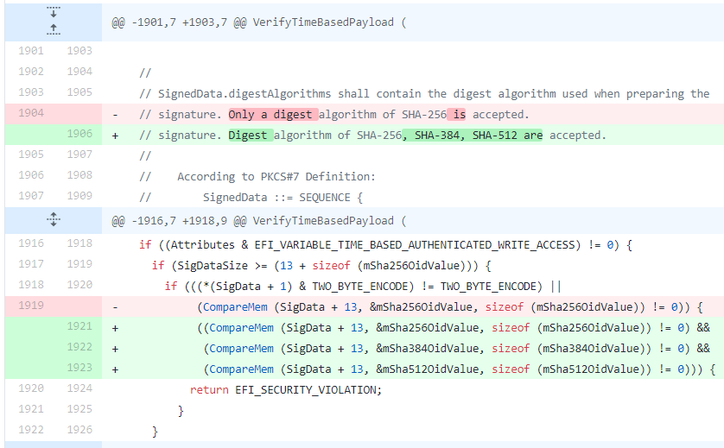
Background
https://github.com/tianocore/edk2-staging/compare/about...divneil:Bugzilla2950-AuthService-extending-digest-algorithm-support?expand=1

Slide 4
Concern: (Summary from 2950)
#1 – Specification
Prefer “future-proof wording does not exclude future algo.”
E.g. What about SHA3? What about SHA-512/256?
Proposal:
Remove text.
Refer to Algo in EFI_HASH2_PROTOCOL. (NOTE: MD5 and SHA1 are still there…)
Find a new place to describe the algorithm.
#2 – minimal and downgrade
What if a PK uses SHA-384 in the beginning then change to SHA-256 PK?
What if a PK uses SHA-384 in the beginning then change to SHA-512 PK?
#3 – capability detection
How can a caller detect the platform BIOS capability to support SHA-384/SHA-512?
Do we support *multiple* signatures on different HASH?

Slide 5
Crypto Agile – Current Status (UEFI)
UEFI cryptography agile
https://bugzilla.tianocore.org/show_bug.cgi?id=3413
UEFI spec
EFI_VARIABLE_AUTHENTICATION_3_CERT_ID descriptor only defines EFI_VARIABLE_AUTHENTICATION_3_CERT_ID_SHA256.
EFI_VARIABLE_AUTHENTICATION, “Only a digest algorithm of SHA-256 is accepted.”, “Only a digest encryption algorithm of RSA with PKCS #1 v1.5 padding (RSASSA_PKCS1v1_5). is accepted.”
NOTE: Other HASH: SHA-384/512/SHA3/SM3. Other signing: RSA_PSS, ECDSA, SM2.
“the recommended Platform Key format is RSA-2048”
“Multiple signatures are allowed to exist in the binary’s certificate table (as per PE/COFF Section “Attribute Certificate Table”). Only one hash or signature is required to be present in db in order to pass validation, so long as neither the SHA-256 hash of the binary nor any present signature is reflected in dbx.“
MSFT
https://docs.microsoft.com/en-us/windows-hardware/manufacture/desktop/windows-secure-boot-key-creation-and-management-guidance#12-public-key-cryptography
SHA-1/SHA-256 + RSA-2048

Slide 6
Crypto Agile – Current Status Summary
Mechanism | Algorithm
TCG – EFI protocol / Platform Firmware Profile (PFP) | SHA1/SHA-{256,384,512}/SM3
IETF – Network TLS (RFC8446) | TLS Cipher Suite – for negotiation
DMTF – SPDM (Secure Protocol and Data Model) (DSP0274) | RSA{SSA,PSS}_{2048,3072,4096}/ECDSA_P{256,384,521}+{SHA,SHA3}_{256,384,512}
PCI-SIG – CMA (Component Measurement and Authentication) | RSASSA_3072/ECDSA_P{256,384} + SHA{256,384}
coreboot – Google Binary Blob (GBB) firmware keys | RSA 8192 + SHA512
IBM Power Secure Boot | ECDSA (512 bit) + SHA512
MSFT Secure Boot Key | RSA 2048 + SHA256
UEFI Secure Boot / Auth Variable | RSA 2048 (PKCS1_1.5) + SHA 256 (*Need allow more)

Slide 7
Crypto Agile – Current Status Summary
Policy | Minimal Requirement
Commercial National Security Algorithm Suite (CNSA Suite Guide) | Minimal: SHA384, RSAPSS_3072/ECDSA_P384
PRC CESA Server BIOS Requirement | Minimal: SHA256/SM3, RSA_2048/SM2, ECDSA_256/SM2
ARM Trusted Board Boot Requirements Client (TBBR-CLIENT) for A profile (DEN0006) | Minimal: AES_128, SHA256, ECDSA_256 (RSAPSS_2048)
ARM Platform Security Architecture (PSA) Trusted Base System Architecture (TBSA) for M profile (DEN0083) | Minimal: AES_128, SHA256, ECDSA_256, RSA_3072
OCP Secure Boot | Minimal: SHA384, RSAPSS_3072/ECDSA_P384
UEFI Secure Boot / Auth Variable | *Need provide guidance for compatibility, and for future

Slide 8
Goal
(Minimal)
1. Keep compatibility (Old BIOS + New OS, New BIOS + Old OS)
2. Allow a platform to use the algorithms defined in CNSA.
3. Allow BIOS configure the supported algorithms at build time.
4. Let BIOS report the supported algorithms.
---------------------
Define Policy on which algos are supported.
Support self-descriptive hash / signature.
(TBD)
5. Forbid BIOS to use the unsecure algorithms. (e.g. MD5, SHA1) – (just document ?)
6. Forbid BIOS to downgrad the algorithms (Do we need this?)
7. Allow BIOS configure the supported algorithms at runtime. (Do we need this?)
(Stretch)
8. No need to change spec, if new algorithms are introduced.
Isolate the algo from UEFI spec. A standalone document as crypto recommendation on UEFI spec, etc.

Slide 9
Proposal – Phase I
Spec:
Move crypto algorithm context from UEFI spec to a UEFI-crypto guideline.
The document can evolve independently.

Slide 10
Proposal – Phase II – Multiple Algorithm
Spec:
Let BIOS support multiple signature (for auth variable set)
BIOS support SHA256 (old) + SHA384 (new)
OS (caller) can provide both SHA256 (old) + SHA384 (new)
Let BIOS report crypto algorithms
OsIndicationsActivatedCrypto RO Variable (Hash, Asymmetric)
Absent means SHA256+RSA2048
EDKII:
Let BIOS choose a subset of algorithms at build time (PCD).
Let BIOS report OsIndicationsActivatedCrypto.

Slide 11
Proposal – Phase II – Compatibility Issue
New OS + Old BIOS
If (EFI_SYSTEM_TABLE.Header.Revision <= 2.9) || (No OsIndicationsActivatedCrypto)
It is an old BIOS. Choose SHA256/RSA2048.
Endif
New BIOS + Old OS
BIOS MUST support SHA256/RSA2048. It may support SHA384/RSA3072.
BIOS supports SetVariable() with SHA256/RSA2048.
db/dbx shall include both old cert (RSA2K) + new cert (RSA3K).
RISK: PCR7. Does BitLocker have special expectation on PCR7 data (db/dbx) ?
[Solution in next page…]

Slide 12
Proposal – Phase II – OS based activation
Spec:
Let BIOS support crypto algorithms selection.
OsIndicationsActivatedCrypto RO Variable (Hash, Asymmetric) // BIOS report to OS
OsIndicationsSupportedCrypto RO Variable (Hash, Asymmetric) // BIOS report to OS
OsIndicationsPreferedCrypto RW Variable (Hash, Asymmetric) // OS set to BIOS
EDKII:
Let BIOS report OsIndicationsActivatedCrypto.
Let BIOS report OsIndicationsSupportedCrypto.
Let BIOS handle OsIndicationsPreferedCrypto.

Slide 13
Proposal – Phase II – Compatibility Issue
New BIOS + Old OS
BIOS MUST set SHA256/RSA2048 as ActivatedCrypto, by default.
BIOS MAY set SHA256/RSA2048+SHA384/RSA3072 as SupportedCrypto.
Old OS will ignore this variable and continue use the old algo.
New OS will use set PreferredCrypto and reboot the system.
BIOS MAY set SHA256/RSA2048+SHA384/RSA3072 as ActivatedCrypto.
RISK: Use swap the OS from new to old, but did not change ActivatedCrypto back.
BIOS SHOULD provide setup page to allow user set the PreferredCrypto.

